Slide 1
Async programing

Slide 2
Synchournous programming
Client
server
Data base
DB
getData()
getData From server
Get data from DB
Render data to screen
May take several seconds

Slide 3
Synchournous programming
Client
server
Data base
DB
getData()
getData From server
Get data from DB
Render data to screen
Synchrnous coding
May take several seconds

Slide 4
Synchournous programming
Client
server
Data base
DB
getData()
getData From server
Get data from DB
Render data to screen
May take several seconds
The code will run and the render to screen will be without data, when it will try to render

Slide 5
Thread-blocking programming
Wait until the data will come back (promise)
Client
server
Data base
DB
getData()
getData From server
Get data from DB
Render data to screen
May take several seconds
Write to console “done”

Slide 6
Thread-blocking programming
Wait until the data will come back (promise)
Client
server
Data base
DB
getData()
getData From server
Get data from DB
Render data to screen
May take several seconds
Write to console “done”

Slide 7
Thread-blocking programming
Wait until the data will come back (promise)
Client
server
Data base
DB
getData()
getData From server
Get data from DB
Render data to screen
All other commands will wait until data is recived
May take several seconds
Write to console “done”

Slide 8
Multi Thread-blocking programming
Wait until the data will come back (promise)
Client
server
Data base
DB
getData()
getData From server
Get data from DB
Render data to screen
All other commands will wait until data is received
May take several seconds
Write to console “done”
But we have many threads, and other commands can continue

Slide 9
JS: singe thread non-blocking programming
The event loop is like a proxy for promises
It can hold many parallel promises, without blocking the thread
Event loop
Client
server
Data base
DB
getData()
getData From server
Get data from DB
Render data to screen
May take several seconds
Write to console “done”

Slide 10
JS: singe thread non-blocking programming
The event loop is like a proxy for promises
It can hold many parallel promises, without blocking the thread
Event loop
Client
server
Data base
DB
getData()
getData From server
Get data from DB
Render data to screen
May take several seconds
Write to console “done”

Slide 11

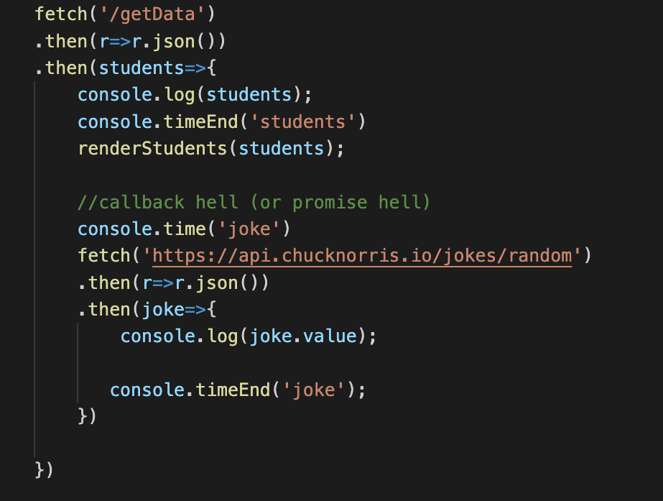
Simple promise

Slide 12
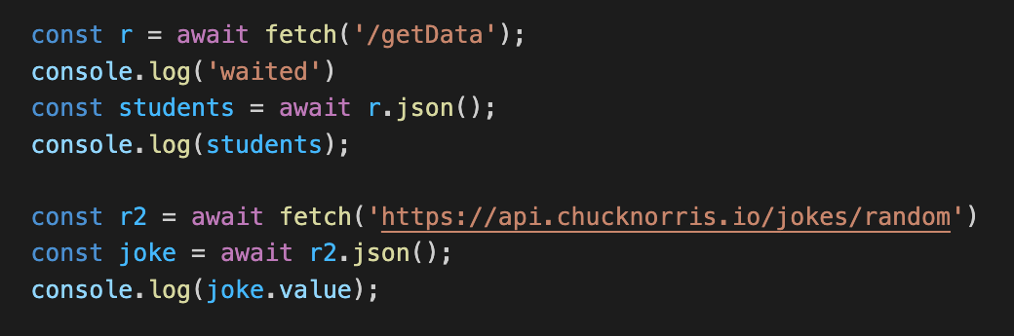
The same thing in async await function

Slide 13
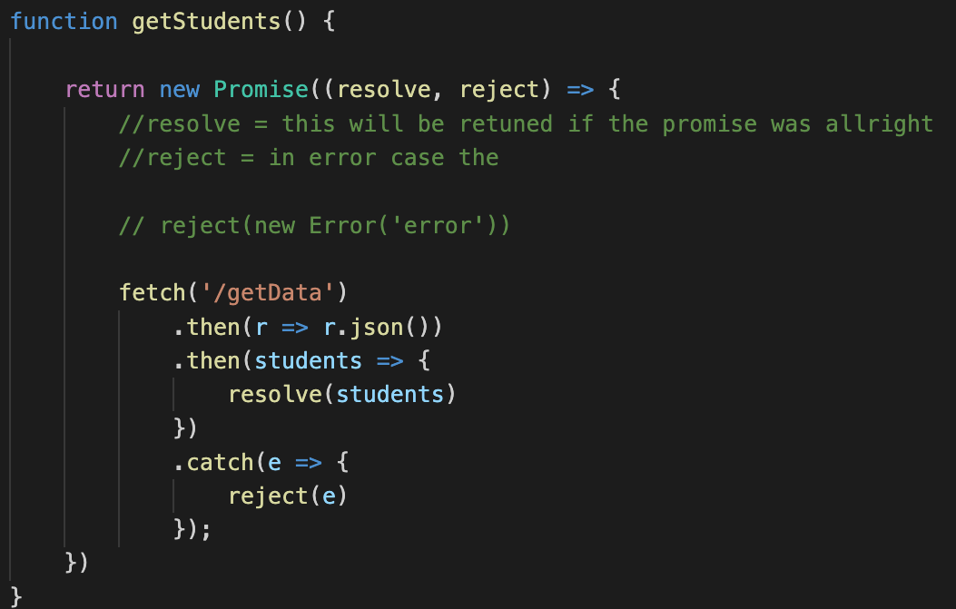
Creating a promise

Slide 14
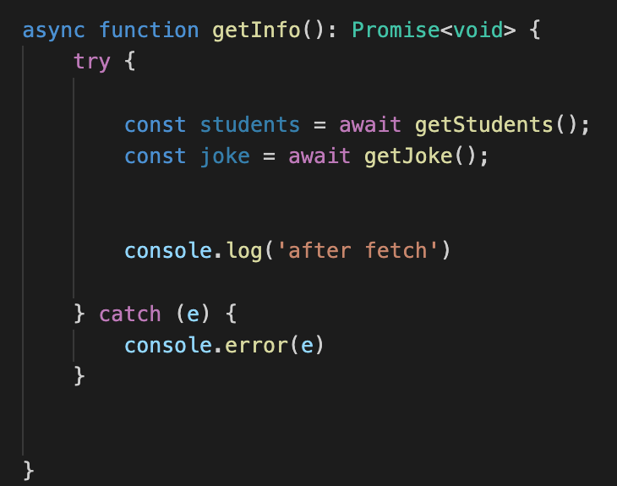
Creating a promise and using it inside an async function

